Slide 1
Addressing the Needs of Underrepresented Groups & Special Populations
Module 7B: Ethnicity
Notes:
[Music Intro]
Welcome! In this module, we will address the needs of underrepresented groups and special population specifically, ethnicity

Slide 2
Learning OBJECTIVES (1)
Identify the strategies & techniques to overcome the barriers to completion
Barriers
Device strategies & techniques
Notes:
Slide 2: Learning Objectives (1)
Today’s learning objectives are as follows. [click]
First, we will identify the strategies and techniques to support the needs of students. [click]
In order to devise strategies and techniques to support the students, we MUST find out what are their needs. [click]

Slide 3
Learning OBJECTIVES (2)
Identify the strategies & techniques to overcome the barriers to completion
Barriers
Device strategies & techniques
Notes:
Slide 3: Learning Objectives (2)
Second, identify the strategies and techniques to overcome the barriers to completion. [click]
To come up with strategies and techniques, we need to know what kind of barriers are preventing the student from completing a program.

Slide 4
Learning OBJECTIVES (3)
Identity the different ways institutions can implement to keep the students engaged.
Notes:
Slide 4: Learning Objectives (3)
Third, to identify the different method institutions can implement to keep the students engaged. [click]

Slide 5
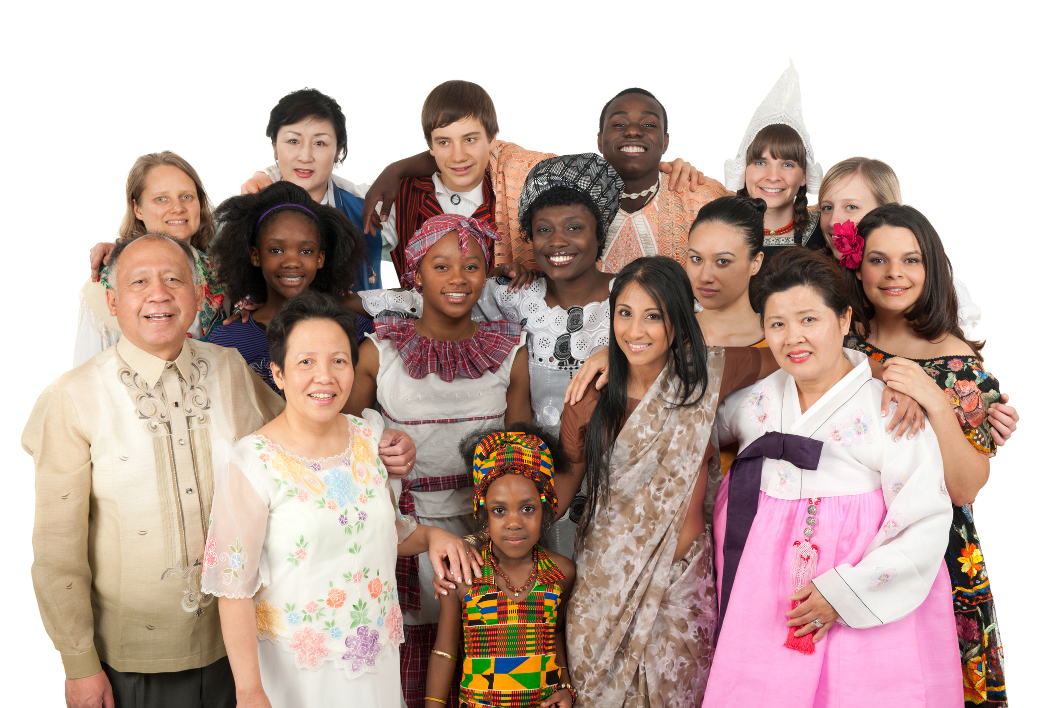

Introduction
Notes:
Slide 5: Introduction
As the student population in the United States continues to become more ethnically diverse, one of the challenges facing education is how to provide school experiences that maximize the participation and academic success of all students. Adding to the challenge for colleges and universities is student retention and graduation for students of ethnic minorities. [click]

Slide 6
Ethnicity
What Is?
Shared culture and way of life
Language
Religion
Culture
Food
Clothing
Music
Art
Notes:
Slide 6: Ethnicity, What Is?
Before we dive in further, let us define ethnicity.
What is Ethnicity? [click]
According to sociology, it is a concept that refers to a shared culture and a way of life. This is reflected through language, religion, material culture like clothing and food, as well as cultural products like music and art. [click]

Slide 7
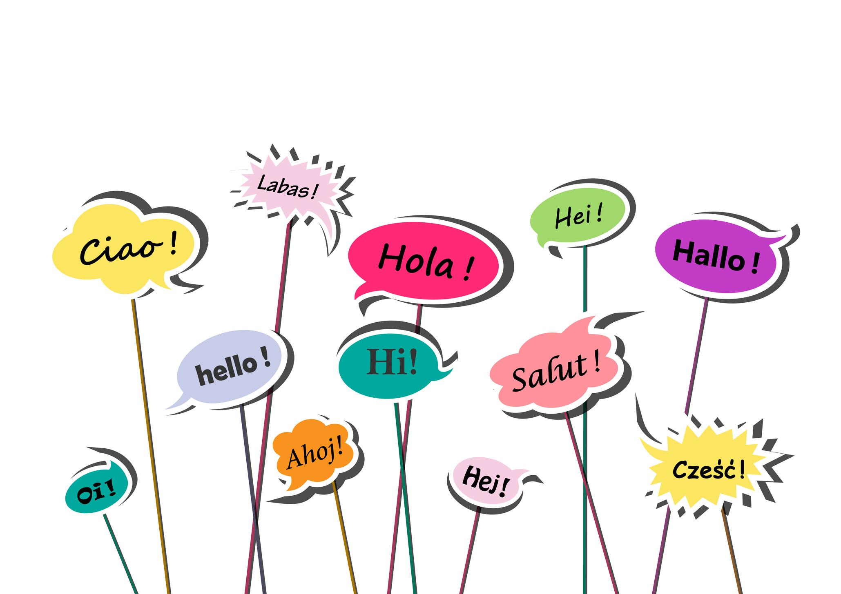

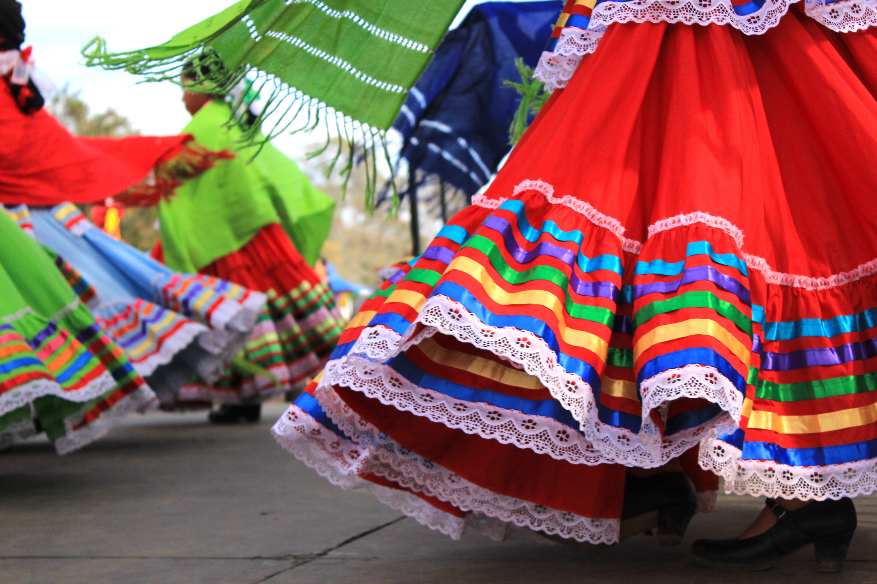



What is Ethnicity?
Notes:
Slide 7: What is Ethnicity?
It is often a major source of cohesion as well as social conflict.
Images
show images with different languages
Images with different religion
Images showing different cultures
Music, clothing, food, and art

Slide 8
Ethnicity
Large group of people with the same origins
National
Racial
Cultural
Notes:
Slide 8: Ethnicity
In its simplicity, it can be defined as a large group of people who have the same national, racial, or cultural origins. It is also the state of belonging to such a group. [click]
[Add image of people with different ethnic group]

Slide 9
Lesson 1:
Strategies & Techniques to Support the Needs of Students
Notes:
Slide 9: Lesson 1: Strategies and Techniques to support the needs of students
Lesson 1: Strategies and Techniques to support the needs of students. [click]
In this lesson, we will identify the educational needs of the students from different ethnic group and identify the strategies and techniques to support the needs of the students.

Slide 10


Student NEEDS (1)
Diverse Academic and Social Needs
Notes:
Slide 10: Student Needs
When we talk about student needs, this can be focused on the diverse academic and social needs of racial and ethnic minority students.

Slide 11

Strategies and Techniques (1)
Improve Admission Process
Enrollment Programs
based on Higher Education Act
Notes:
Slide 11: Strategies and Techniques
To support the academic needs of students, community colleges and/or universities can improve their admission process. One way is by providing equitable admission standards.
Community colleges can use two types of programs to help in the enrollment - enrollment programs and transition programs. Enrollment programs are based on legislative mandates, for example based on the Higher Education Act (HEA) of 1965 which provides resources for college students, like financial aid and continuing education programs.
Enrollment programs work to make sure that a certain percentage of enrollments are members of racial or ethnic minorities.

Slide 12

Strategies and Techniques (2)
Offer Suitable Program & Create Appropriate Policy
Level the admission process
Transition Programs
Notes:
Slide 12: Strategies and Techniques continue
Offering suitable programs and creating appropriate policies helps racial and ethnic minority students make successful transitions from high school to college.
Transition programs are programs and related services to assist students who may not necessarily qualify or gain admittance to community colleges or universities through traditional means.
Using the transition programs, colleges and universities can level the admission process for racial and ethnic minorities.

Slide 13

Strategies and Techniques (3)
Cope with Issues in Campus
Cultural Enrichment Activities
Notes:
Slide 13: Strategies and Techniques (3)
To help students with social issues, colleges need to devise plans of action to help the minority students cope with issues they may face on campus.
Offer cultural enrichment activities that promote college readiness and social integration on campus.

Slide 14
Student NEEDS (2)
Lack of Preparation/ Knowledge
Notes:
Slide 14: Student Needs continue
Another student need is the lack of college preparation and/or knowledge of being a successful student.

Slide 15

Video Component (1)
Notes:
Video Component
https://youtu.be/WBHLRKz6NYA

Slide 16
Lesson 2:
Strategies & Techniques to Overcome the Barriers to Completion
Notes:
Slide 16: Lesson 2: Strategies and Techniques to Overcome the Barriers to Completion
In this lesson, we will identify different strategies and techniques to overcome the barriers to completion.

Slide 17





Barriers to
COMPLETION
(1)
Disparities in Education Attainment
Notes:
Slide 17: Barriers to Completion (1)
The first barrier in this lesson is Disparities in Educational Attainment.
This barrier is very significant especially when it comes to wage and employment disparities with many different ethnicities.
Countering the disparities in educational attainment through skills-focused policies is a key piece in addressing wage and employment disparities, closing the nation’s skill gap, and improving the nation's overall economy.

Slide 18

Barriers to
COMPLETION
(2)
English Language Learning
19 Million
Notes:
The next barrier is being proficient with the English language. [click]
Disparities in English language proficiency contribute to disparities in educational completion, employment, and earnings. According to research more than 19 million working-age American adults are English learners, including 12.7 million who are currently employed. [click]
Overall, English learners represent one in nine workers in the United States. English learners are also disproportionately people of color. English skills are vital for obtaining and advancing in many types of employment, particularly in fast-growing personal and business services occupations where workers have extensive interpersonal interaction with customers and co-workers.

Slide 19
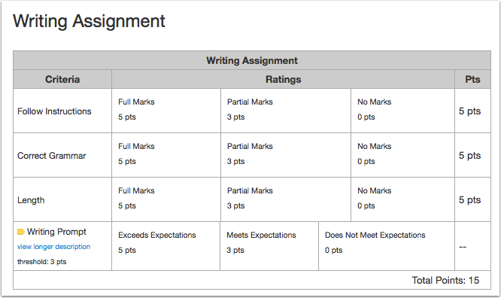
Overcome the BARRIER (1)
Ensure Fair Assessment
Notes:
Slide 19: Overcome the Barrier (1)
To overcome the language barrier, some of the techniques and strategies that we can do are: [click]
To Ensure fair assessment. For assessments, such as entrance exams, course assessments, and competency/proficiency tests, we must remember to separate language skills from content skills. Language skills may include vocabulary, comprehension, grammar, syntax, etc. [click]
Content assessment focuses on comprehension, whether or not the student was able to understand the subject matter. One way to implement this is by recommending to the instructor to use a rubric for grading student work. The professor can create some sort of grading scale or grading rubric to identify the language skills and content skills.

Slide 20

Overcome the BARRIER (2)
Provide Quality Instructions and Resources
Notes:
Slide 20: Overcome the Barrier (2)
Providing students with quality instructions and resources.
The learning opportunities that many English Language learners receive is different than their native-speaker counterparts. Research suggests that effective English-language learning classrooms foster a strong environment of collaboration, dialogue, and group engagement.
It is important that students have multiple opportunities throughout the day to engage their oral language skills. Working collaboratively fosters a culture of community in the classroom.

Slide 21

Barriers to
COMPLETION
(3)
Financial Burden
Notes:
Slide 21: Barriers to Complete (3)
Another barrier is financial burden.
College students are constantly worried about money. It is a sensitive topic and that’s especially true for college students. Getting through higher education means constantly thinking, worrying and stressing about how to afford it. Financial stress makes everything else harder.

Slide 22

Overcome the BARRIER (3)
Grants, Scholarships, Emergency Aid, Work Study Program
Notes:
Slide 22: Overcome the Barrier (3)
To combat financial burden, provide resources and information for grants, scholarships, emergency aid, and work study program.
Provide on-campus financial advice. If you are a student, make sure to connect with the CTE/Workforce office(s). If you work for CTE and Workforce offices, devise some programs to reach out to students who are in the CTE programs.

Slide 23

Barriers to
COMPLETION
(4)
Alienation, Marginalization, & Loneliness
Notes:
Slide 23: Barriers to Complete (4)
Students experience alienation, marginalization, and loneliness.
These issues and challenges can directly or indirectly impact on academic performances and can become barriers to completing their programs. Professors’ expectations and attitudes, cultural conflicts, motivation, may be additional hindrances.

Slide 24

Overcome the BARRIER (4)
Specialized Advising, Counseling Services, Mentoring Program
Notes:
Slide 24: Overcome the Barrier (4)
Establish specialized advising, counseling services, and mentoring program.
One important component of successful retention is to create specialized advising and counseling services. This type of retention program can focus on academically at-risk students. Advisors and counselors can offer special academic development programs that offer orientations and instructional assistance.
Based on research students tend to utilize the services when people of the same ethnicity are present. Having counselors or advisors of the same ethnicity tend to help.
Faculty mentors or advisors can provide useful information and advice. Upper-class students of the same or similar ethnic background can offer guidance to incoming freshman students. They can provide support both socially and academically.

Slide 25
Lesson 3:
Different Ways Institutions Can Implement to Keep Students Engaged
Notes:
Slide 25 : Lesson 3 - Different Ways Institutions Can Implement to Keep Students Engaged
Lesson 3 will talk about some of the different ways institutions can implement to keep students engaged. Let’s proceed.

Slide 26



Strategies and TECHNIQUES
(1)
Apprenticeships and Certificates
Notes:
To secure good middle-skill jobs, students can complete apprenticeships-on-the-job training with a classroom component. Institutions can work with local businesses to train students on the job while in the program.
An associate degree is not the only middle-skill postsecondary credential of value in the labor market. Students can also earn college certificates in fields like healthcare, transportation and distribution, and advance manufacturing career that can lead to lucrative careers.

Slide 27
Video Component (2)
Notes:
Video Component:
https://youtu.be/XxXvlQogRys

Slide 28



Strategies and TECHNIQUES
(3)
Provide Optimal Learning Environments
Notes:
Due to growth in racial and ethnic minority participation in higher education, colleges need to provide optimal learning environments and a welcoming environment for students representing a variety of multicultural and ethnic backgrounds.
This can be done by offering multiple pathways through guided pathways and scaffolded instruction to meet the needs of diverse learners.

Slide 29
Video Component (3)
Notes:
Video Component
https://youtu.be/zhdt75uLS7g

Slide 30

Strategies and TECHNIQUES
(4)
Training & Workshops for Faculty
Notes:
Provide training, workshops, and consultations to faculty to better equip them in integrating multiculturalism in the classroom, and to promote and develop an inclusive learning environment. The better training and support the faculty receive, the more they can handle different classroom ethnicities.

Slide 31
Credits
Module 7B: Ethnicity
Addressing the Needs of Underrepresented Groups & Special Populations
Notes:
[background music while the credits are showing]
Add the resources and a quick preview of the next module - Module 7C - Veterans, Student with Disability and First-Generation College Students

